Slide 1
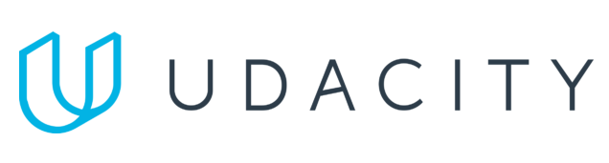
Data Lake Value Proposition
Medical Data Processing Company
CAO HOAI PHUONG
Udacity IPS Version 1.0
Notes:
25s
Welcome lady and gentleman, thank you for your be here.
Today we propose to "Medical Data Processing Company" the Data Lake Architecture Solution to solve currrent problem that facing to hyper growth over the past 3 years.
Currently, the volume of data continues to grow, the on-premise SQL Server is not able to scale that lead to we only process the data nightly due to the compute capacity limitations
beside that ETL processes and SQL reporting queries daily are running slow due to increased data volumes.

Slide 2
Agenda
What is a Data Lake
Components of a Data Lake
Data Lake vs Data Warehouse
Business Value of Data Lake Solution
Proposed Data Lake Architecture for Medical Data Processing system
Udacity IPS Ver. 1 2/2020
Notes:
40s -> 1:05
I would like to sumary our content today that includes
First we will go through the defination of the data lake to find out what it is
Then, is exploring the main components of an data lake and their responsibility.
Sometime, people confused about data lake and data warehouse, we are going clarify their differnt beside that when they would be apply by use cases.
Keep going, the most importance thing that is what benefits and enabler of data lake to the company business.
Finally, the our proposed Data Lake Architecture for Medical Data Processing system that will put all in place and ready to consideration.

Slide 3
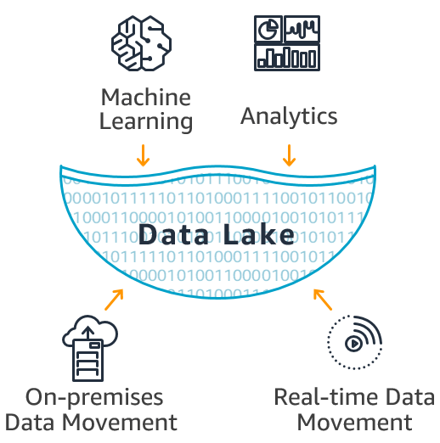
What is a Data Lake
10,000 foot view
Notes:
10s -> 1:35
Fisrt Thing, I would like to show the activity of and data lake in some view of point.
At 10,000 foot view. The high-level framework for a data lake that show how analytics systems work with source and destination systems.
Data Lake is a central place where we can bring together data, Machine Learning, and Analytics.
Where the data movement activity together with data processing, cleaning, transfoming to make them be ready to analytics.
The machine learning could be apply in any aspect likes data filtering, processing or in decision making.

Slide 4
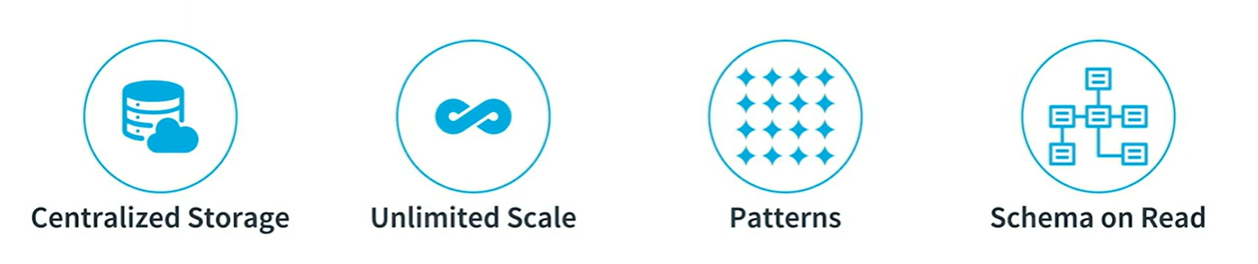
What is a Data Lake
5000 foot view
Notes:
60s -> 2:35
Come nearer with 5,000 foot view.
Data Lake is a central place where we can bring together data, Machine Learning, and Analytics and
can store data of any type, including unstructured, semi-structured, and structured at any scale.
This ultized distributed storage technologies likes Hadoop HDFS and cloud native storage
so that we do not need to care about how to scale to meet new requirement.
Datalake help to breaks data silos in company by bringing all the crucial enterprise data under one centralized system.
This makes it easy for different organizations within a company to collaborate.
It propose Schema on Read approaching by writing the data in the data lake its original raw format. And enforce the schema when you need to read this data back.
This makes the process of writing different types of data to data lake at scale very hard to achieve as schema generally evolves very quickly.
The Data Lake democratizes data and is a cost-effective way to store all data of an organization for later processing.
Data Analysts within the company can focus on finding meaningful patterns in data with more visibility and easy access to the required data.

Slide 5
Components of Data Lake
Data Storage : Centralized data storage is compatible with file systems supported by Apache Spark like HDFS, AWS S3. Normally under open format like parquet, ORC ... for storing data, providing efficient compression and encoding schemes.
Data Ingestion: the first checkpoint when data in it native format enter to the data lake that ingested from various external sources such as files, applications, APIs, and streaming platforms ...
Data Processing: data layer where executes data processing tasks that include data cleansing, denormalization, and consolidation of different objects.
Data Serving: data stored in files or tables and makes it accessible and ready for consumption that ready for analysis and insights generation.
Data Catalog: the metadata repository that known as data about data is used to manage the data in the data lake. Governace and Security: controlling over data quality, acurate and compliance also provides centrally manage and scale fine-grained data access permissions.
Notes:
65s -> 4:40
At this. we will explore the major components of the data lake and their responsibilities.
they are incluces: Data Storage, Data Ingestion, Processing and Serving and the importance other that Data Catalog, Governace and Security.
First is Data Storage that one place to store compay data. This centralized storage ultilize the distributed file system technology that spread to store on multiple file servers or multiple locations.
About Data Ingestion that acvicity and first place where data enter into data lake in its native format.
Once, Raw data came in place they will be executes data processing tasks that include data cleansing, denormalization, and consolidation of different objects by Data Processing.
After processed. Data stored in files or tables and it accessible and ready for consumption that ready for analysis and insights generation. Data Serving take this responsitory to provide this to end users.
The important component of data lake that is Data Catalog work as is the metadata repository that known as data about data is used to manage the data in the data lake.
Its helps data consumers discover, understand, and consume data more productively. Empowers data analysts and users to work in self-service mode to discover trustworthy data quickly
Data Governance ensure data quality, compliance, and lifecycle policy requirements regarding data usage and Data Sercurity protect sensitive data through encryption, authentication, and access control.

Slide 6
Data Lake vs Data Warehouse
Data lakes and data warehouses are similar in that they both store and process data, each have their own specialties, and therefore their own use cases. That's why it's common for an enterprise-level organization to include a data lake and a data warehouse in their analytics ecosystem. what's the difference between a data lake and a data warehouse? And when is it appropriate to use one over the other?
Notes:
30s -> 5:10
Organizations today have access to ever-increasing volumes of data
they use various tools and solutions to achieve their data analytics outcomes.
Data warehouses and lakes are all solutions that help with storing data and increase the data's availability, reliability, and security.
But practical usage data lake differs greatly from that of a data warehouse
Next, We will go for the key points of difference between the two of solutions.

Slide 7
Data Warehouse
Data Lake
Only relational, structured data
Data required for analytics is kept, since data warehouse costs are high
ETL (Extract, Transform, Load) process
Schema is On-Write
Optimize for Query performance
Highly curated data
Reporting, BI and visualization
Store any type of data-raw, structured, and semi-structured
Petabytes of data can be stored for very long periods since storage costs are low
ELT (Extract, Load Transform) process
Schema is On-Read
Data storage and processing flexibility
Data curated or may not ( raw data)
Machine Learning, prrdictive analytics, data discovery and profiling
Udacity IPS Ver. 1 2/2020
Notes:
80s -> 6:30
The first differ is storage approach.
Data lake was born to store any type of data as raw, structured, and semi-structured
while Data Warehouse only support relational or structured data.
So that Data Warehouse is best for date analytics storage with cost are high.
in opposite, with the low in storage costs that suitable to keep Petabytes of data in data lake.
Data warehouses require ETL operations that transform raw data into a predefined structure, often known as Schema-on-Write.
Data lakes employ the Schema-on-Read paradigm.
Extract, load, and transform (ELT) process are often used in data lake.
the feeding data into the lake and then transform it only when necessary in which a schema is constructed only when the data is read.
A data warehouse is built to provide the quickest query performance possible that allow for faster reporting.
On other hand, favors storage volume and cost over performance are the advantages of data lake.
That are the result. Data in WH is highly curated data.
However, Data lake is not. Due to, it store vary of data type including raw data.
Finally, Best use cases of data WH are Reporting, BI and visualization.
And Data lake is best for machine Learning, prrdictive analytics, data discovery and profiling.
In Organization two of solution could be presented to saticfiy the specific business requirements.

Slide 8
Business Value of Data Lake
The data lake architecture by distributed object storage in nature and can scale easily that to help company to solves data storage scaling at Data Volume Growth rate 15-20% YoY. So that this can meet company’s demands at any scale.
Data anlytics workloads will not be a problem like as when on-primes met the scalability issues with the current SQL server. Cloud-based solution such as Presto, HBase, Redshift, Athena can be used to directly read data from the data lake in a distributed manner that automatically and elastically scales query processing power. So that we don’t need to run batch processing in nightly anymore.
This architecture addresses data silo and duplication issues. Central medata-storage that known as Data Catalog managment help to enable business innovation by allow downstream consumer can discovery much as much any of data aspects.
Data Lake can be a good enabler of machine learning, artifical inteligence and big data as it offers a scalable storage that is distributed in nature.
Notes:
80s -> 7:50
The data lake applying brings to organozation many business value such as
Improving current legacy that can not scale easy in storage.
The data lake architecture solves seamlessly, it alow to store huge of data at any scale.
SQL server performance issue could be solve and data anlytics workloads will be done in real-time
Not need to run by batch in nigtly anymore.
Cloud-based services like as Hive, Redshift, Athena can be used to directly read data from the data lake
Automatically and elastically scales query processing power
Data lake break down data by making data to be consolidated and easily accessed
Enabling users with completely different skills, tools and languages to perform different analytics tasks all at once.
Additionally, it allow raw data can be retained indefinitely at low cost for future use in machine learning and analytics.
More and more, value of data lake that could be explored by yourself.

Slide 9
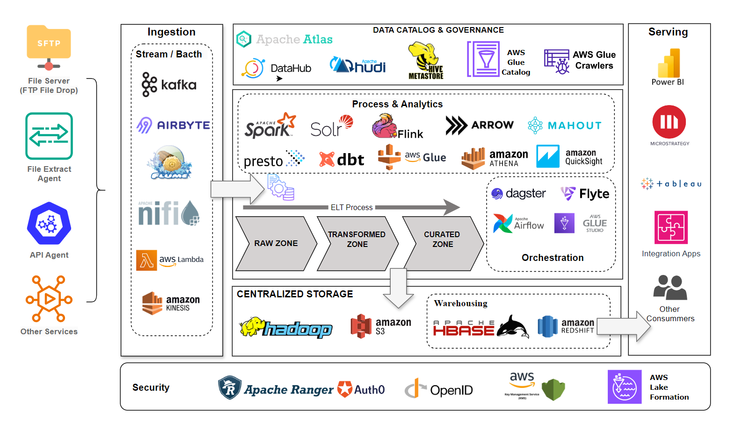
Data Lake Architecture
Notes:
130s -> 10:00
The Data lake Architech Diagram propose to build on cloud than on-premises.
Cloud-based allow enterprises flexible usage and access to resources as needed with
No upfront investment in hardware and infrastructure, reduces the need for internal maintenance resources
scalable with the ability to adapt quickly. Changing business needs without significant additional costs.
That meaning you only“Pay as You Go.
Begining, Ingestion layer is tasks to sink data into data lake that wil be done with vary of open source tools likes as
KafKa, AirByte, Flume to load data in batch, real-time or streamming.
Align with open source tools, cloud-based provides specific servies like
AWS Snowball to mirate huge of data from on-premises to cloud AWS DMS for RDMS migration. AWS Glue, Batch, Kenesis for the loading and streamming data.
In detail, Diagram address. Central data storage is base on the distributed file storage systemsuch as
Hadoop HDFS or cloud-base S3 object storage service (AWS) that offering the calability, data availability, security, and performance.
Beside that Redshift is the solution for the best price-performance cloud data warehouse
allow to share and collaborate on data easily and securely within and across organizations
Data Processing and Anlytics workload could be done on cloud enviroment the support tools
are ready and easy to use like AWS Lambda, EMR, Glue, Athena ...
Many selection to achive analytic and processing requiement.
Data Management team could leverage Governace and sercurity tools like as
Apache Atlas, Hive metastore, Hudi ..
Besides AWS services IAM, KMS, Lake Formation, Glue Data Catalog, Glue Crawler to manage every aspects of
datalake.
Ultimately. filtered, cleaned, transformed data can be accessible in Serving layer for comsumner
End-user can be any one. Data Analytics Engineer, Data Scientist or any data comsuming application.
Thanks you.

Slide 10
THANK YOU
Udacity IPS Version 1.0

